Slide 1



Intellectual Development

Slide 2
Intellectual Theorists:
Piaget: 4 stages – Sensori-motor, Pre-operational, Concrete Operational, Formal Operational
Gardner: 8 intelligences – Verbal-linguistic, Logical-mathematical, Visual-spatial, Musical, Bodily-kinesthetic, Interpersonal, Intrapersonal, Naturalistic

Slide 3
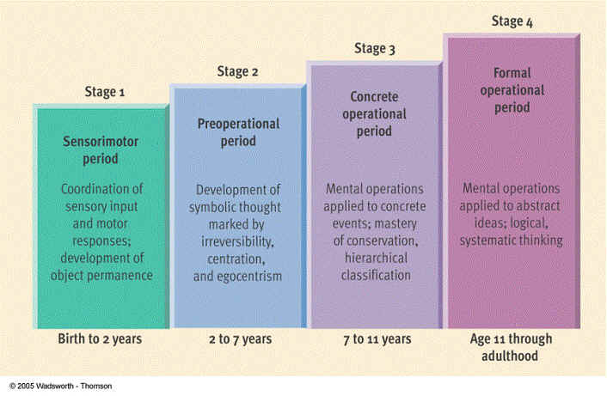
Piaget’s stages:

Slide 4
Piaget - Sensori-Motor Birth – 2 years
Children learn through touching and putting things in their mouths.
Only understands actions and their consequences
  Touch hot stove- OUCH!!!
Primary circular reactions= action serves as a stimulus to repeat the same action (1-4 months) Shake the rattle = like the sound, do it again

Slide 5

Piaget - Preoperational Thinking:
Children 2-7
Use of symbols – can start to understand that symbols mean something.
Make believe play – fantasy and drama plays help to learn roles, school, house…
Egocentric – ME, ME, ME!!!
  I like chocolate so does everyone else. Children understand the world through what they think/feel.
Limited focus –only think in terms of one classifier at a time.
  Tennis balls: 4 white, 7 yellow. Ask child are there more tennis balls or yellow balls, you’ll likely get yellow. They can’t see they are all tennis balls, just see more yellow.

Slide 6
Piaget - Concrete Operational Thinking: Children 7-11
Thinking logically but learn best from DIRECT EXPERIENCE, still need to do something to understand it.
Can understand conservation of material: pour liquid from one container to another does not change it’s amount.
Classification skills are refined to take more into account, such as color, shape, size, quantity, etc.

Slide 7
Piaget - Formal Operational Thinking: Children 11 through Adulthood
Abstract thinking - what might be, what if hypotheses, positive and negative
Deeper understanding and subtle messages, reading between the lines are developed.
Going beyond the self perspective
Transitivity – understand relative relationships, ex. 3>2 and 2>1, so 3>1

Slide 8
Piaget - Formal Operational Thinking: Children 11 through Adulthood cont.
Can start to plan tasks and organize work for efficiency, break down long term projects.
Around 12, capacity for learning and attention goes down for about 2 years, likely due to new interests and puberty.
About 14, learning ability picks back up again.
Young teens still think they can solve complex problems with simple, black and white thinking, don’t see realistic perspective quite yet.

Slide 9
Piaget - Formal Operational Thinking: Children 11 through Adulthood cont.
Middle school students:
  still need more coddling, help from adults, they start switching teachers, but use team approach so that all students can be monitored.
High school students:
  don’t generally need as much personal attention, although I think that’s still important. ☺
Homework at both levels - important, reinforces learning:
  should be more complex than elementary school.
Homework is child’s responsibility, not the parent’s:
  Parents should only support if necessary. Learn independence!!!

Slide 10
Intelligence: What is it?
Tested for over 100 years.
Stanford-Binet: standard intelligence test gives IQ or intelligence quotient, a number to represent intelligence
90-110 normal: If above or below, then considered above or below normal intelligence – gifted or learning disabled

Slide 11
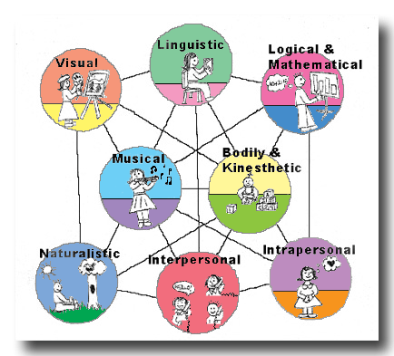
Howard Gardner – 8 Intelligences
We learn best through our strongest intelligence.
What’s yours?

Slide 12
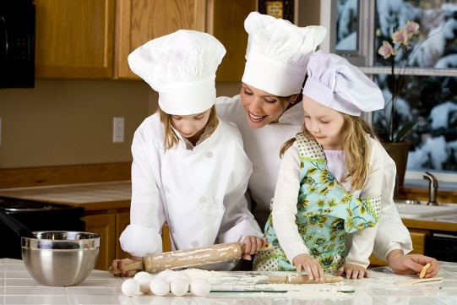
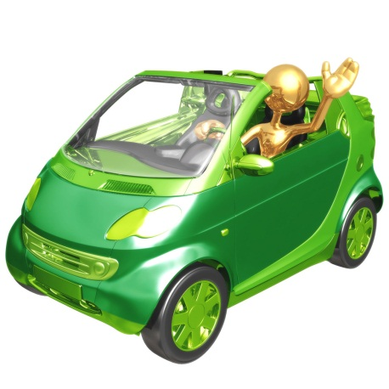

Learning Everyday- Teach-able Moments
Every day occurrences
Questions spur learning
Ask the child to teach you or someone else something - deepens understanding.
Children are curious – use that!!!
Use positive reinforcement and praise, but not to excess.

Slide 13

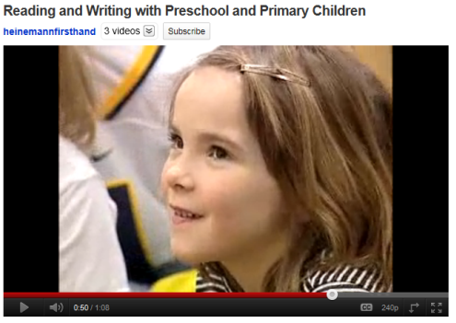

Reading – learning for life
Phonemes - sounds letters make in words.
More reading to children = more learning
Choose great, colorful, vocabulary-rich books.
Children who are bilingual (speaking two languages) actually understand printed words sooner than children who only speak one language.

Slide 14

Choosing the right books
Are books:
  interesting?
  colorful?
  appeal to the child’s interests?
  Include action to hold attention?
  Will the child understand MOST of the words, when they do understand all of them, move onto harder books. Challenge is needed for learning to occur.
  People learn best when they are interested, find what interests a child/person, and they will be more engaged in the learning.

Slide 15
In school
Are they ready for school?
Preschool helps the transition.
Kindergarten helps children learn what school is all about.
Kids should know and be able to tell you:
  who they are, where they live, their phone number, and who their parents are before going to school.
Age often determines when children can start school, but ultimately they should be READY.

Slide 16


Speech Development
Language development can vary by location.
By age 6: 2,500 words are usually understood and used
Articulation = clear, distinct speech, no more “baby talk”
Physical development also plays a role in speech development. Fine motor skills in mouth determine speech.
b, p, m sounds need only lips.
f & v sounds need teeth.
j, ch, st, pl, sl sounds need lips, teeth and tongue to produce.
Please = PWEASE

Slide 17
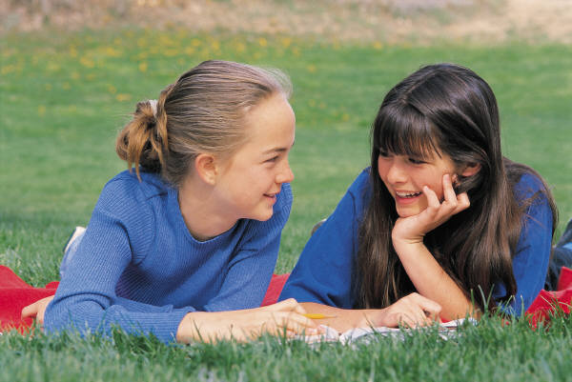
Speech Difficulties cont.
Exposure is key – use high quality words
Problems - try to get help for the child.
Children may tease and make fun of those with differences/disabilities when young. ☹

Slide 18



Special Needs
Gifted
Learning Disabilities
ADD/ADHD
Dyslexia

Slide 19
Special Needs cont.
Two forms of special needs:
  Gifted and Learning Disabled
    Gifted: higher than normal intelligence, IQ usually of 130 and above
      Bored easily if not challenged
      Can have much deeper thoughts
      Usually shows up early by about 2-3 years of age
      Gifted students need recognition and acceptance of abilities
      Ask challenging questions
      If not challenged, can become problem or poor students
      Special enrichment classes, even whole schools, devoted to gifted students

Slide 20
Special Needs cont.
  Learning Disabled: lower than average intelligence, below 90, not linked to physical disabilities
    Can be easily frustrated
    Development is uneven
    Need more or different instruction to learn
    Deprived learning environment not usually cause, nor is mental or emotional problem
    Different types of learning disabilities
    Special classes, part or full time usually within the regular school

Slide 21
Special Needs cont.
  ADD/ADHD – Attention Deficit Disorder/Attention Deficit Hyperactivity Disorder:
    Difficulty paying attention/focusing of task at hand
    Don’t finish what is started
    Some lack emotional control
    May be caused by chemical imbalance in the brain. It can be hereditary, runs in family. Can also be due to mother taking drugs while pregnant.
    Children need to learn to settle themselves, sometimes medication may be necessary.

Slide 22
Special Needs cont.
  Dyslexia – difficulty understanding/interpreting the printed word
    Reverse letters and numbers.
    Difficulty distinguishing left and right.
    Best practice for young children is to teach phonics to help recognize sound/letter connections.
    It’s not that children with dyslexia can’t learn, but they need special approach, and lots of patience to learn.
    Learning disabilities show up usually during school, so it can be hard for parents to accept if they don’t recognize it at home.
    Responsibilities at home also help children feel accomplished, particularly if they are struggling at school.

Slide 23
Sum it up
Intellectual growth is all about the thinking process and how people learn.
Giftedness usually shows up early, disabilities may not show up until child is in school.
Teachers and parents need to recognize struggling children and give appropriate assistance, including specialists.
All children can learn, they just need their best way to learn.

